Slide 1


Training A Neural Network Capable of Predicting a Financial Market
Individual Project Presentation
by: Paul Johannes Aru

Slide 2

Background Information
Machine Learning & Neural Networks
Financial Markets

Slide 3
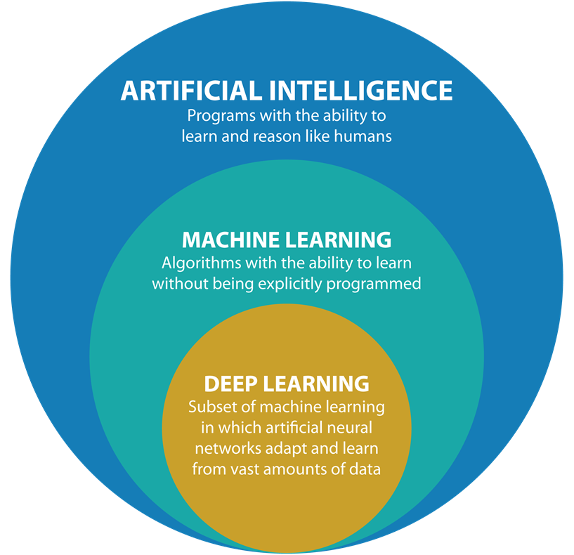
Machine Learning & Neural Networks
“AI” - Gets Thrown Around a Lot!
What is an (Artificial) Neural Network?
A Network of “Weighted” Nodes.
A Trained Prediction Model.
Notes:
AI – a Mainstream Marketing Label. Example: New toothbrush claimed to include “A.I. technology”
Grokking Deep Learning by Andrew W. Trask. Introduced the concept of weights.
Diagram from https://www.argility.com/wp-content/uploads/2018/04/image10.png

Slide 4
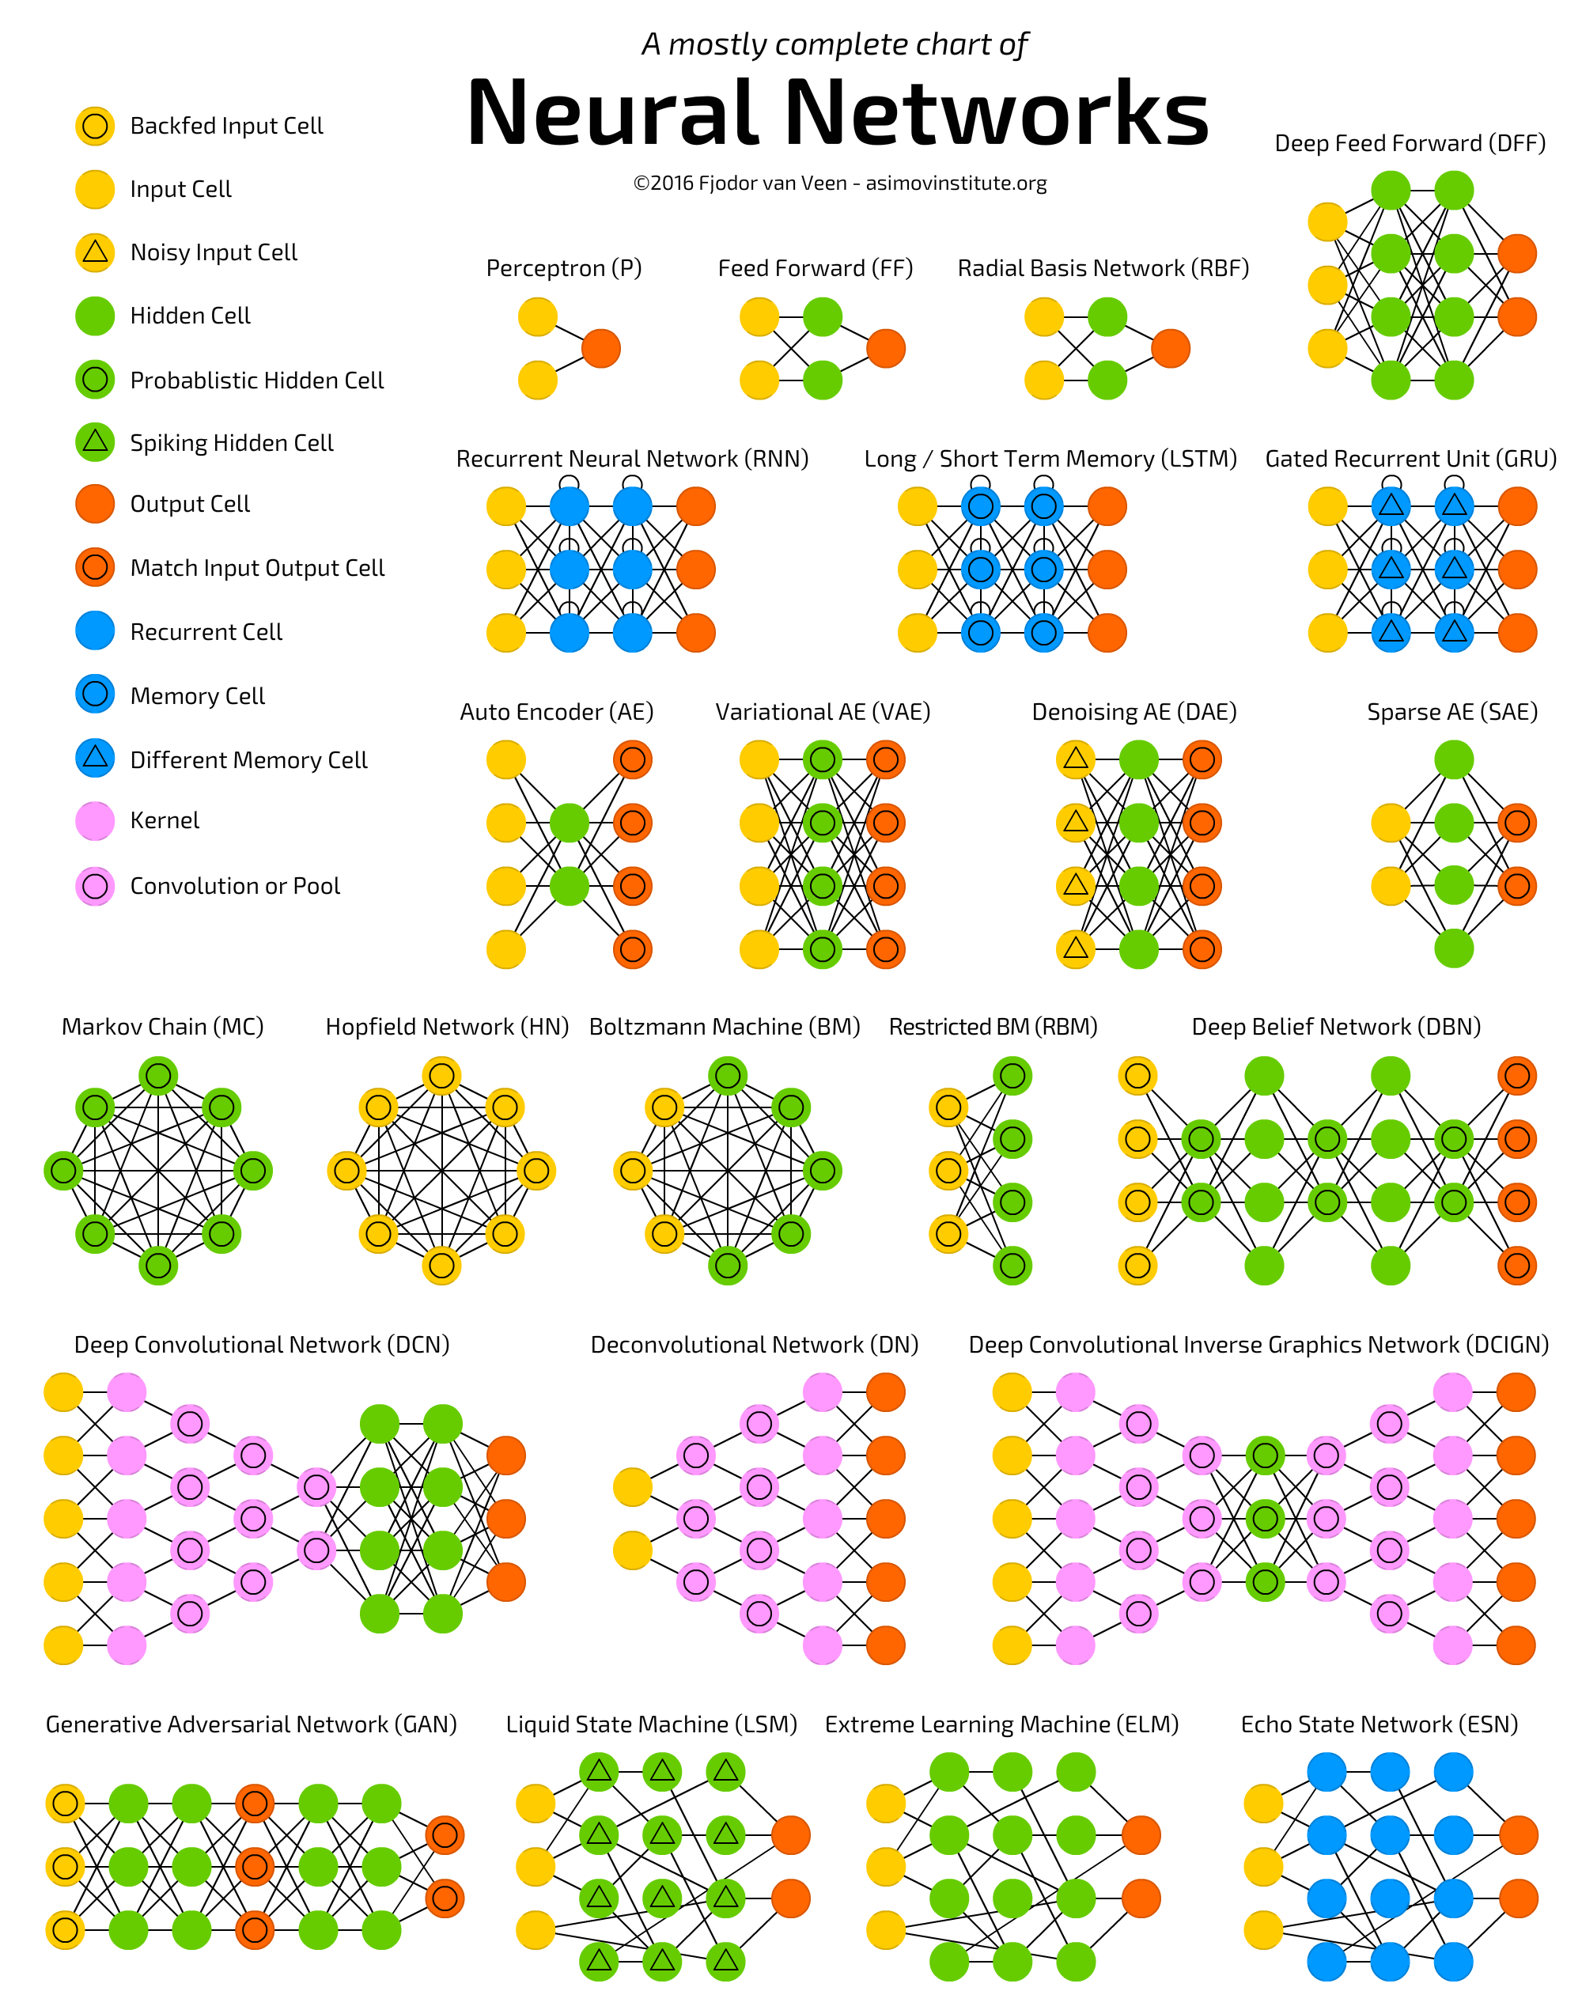
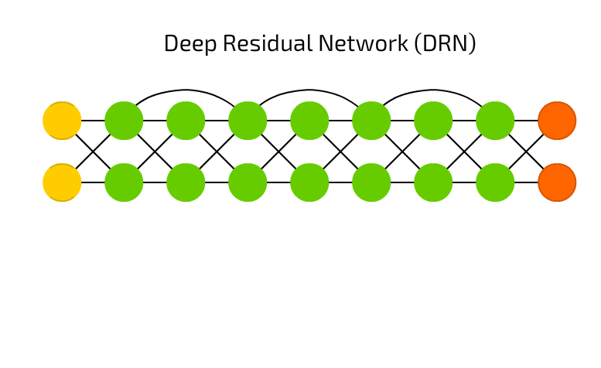
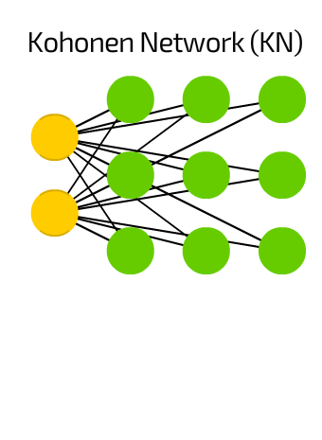
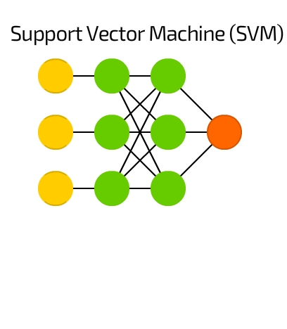
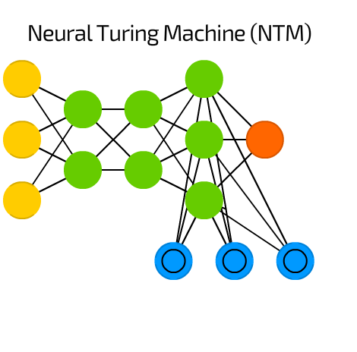
Machine Learning & Neural Networks
A Large Selection of Topologies.
Layers can be Mixed and Matched.
Feed-Forward vs Recurrent Structure.
Notes:
Feed-Forward Network Signals Travel From Input to Output.
In Recurrent Networks Signals can travel in Any Direction.
Mention Hidden Units.

Slide 5
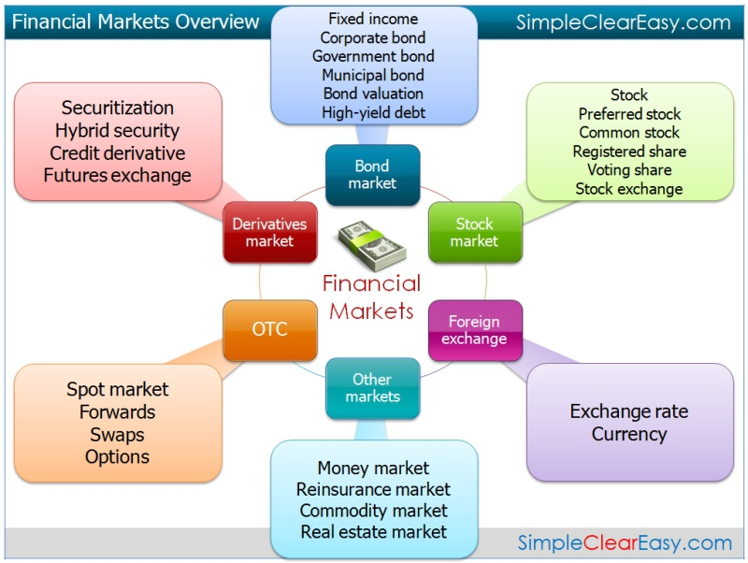
Financial Markets
Not Just Stock Markets!
Countless Exchanges Exist All Across the Globe.
Speculation vs Investment.

Slide 6

Project Information
Technical Decisions
Emerged Findings
Conclusions

Slide 7
Technical Decisions
1. PROJECT DECISIONS
MATLAB Environment.
Long Short-Term Memory Architecture.
Training Data from Yahoo Finance.
Notes:
Advisor Arfan Ghani recommended MATLAB.
Literature Review suggested LSTM.
Yahoo Finance free-to-use.

Slide 8
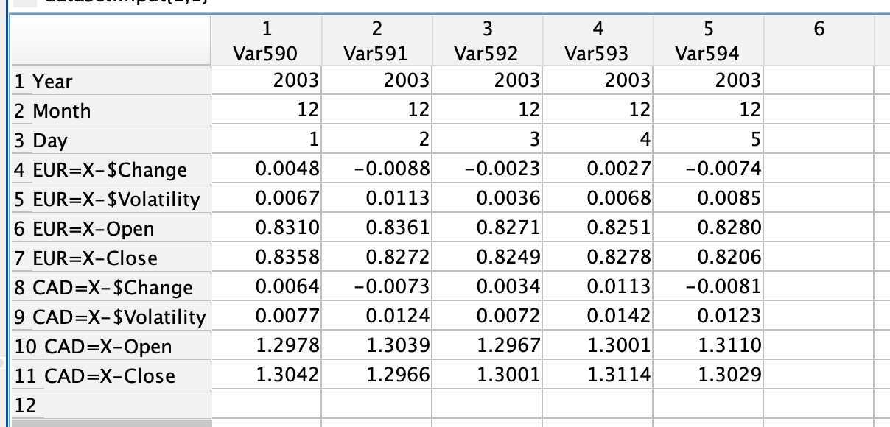
Technical Decisions
Sample Data Point:
Symbol
Window
Classes
2. PERFORMANCE ASSESSMENT
Precise Accuracy
Directional Accuracy
Simulation Earnings
Data Point 1
$5 - $1
Dataset
Data Point 2
$1 - $0.1
LSTM NN Model
Data Point 3
$0.1 - -$0.1
Data Point 4
-$0.1 - -$1
Performance:
Simulation Earnings
Directional Accuracy
Precise Accuracy
Data Point 5
-$1 - -$5
Notes:
Mention Epoch and Batch.

Slide 9
Emerged Findings
1. DATA POINT FINDINGS
Dedicated Window Period Tests Indicated 3-14 Days Perform Best.
Symbol Count Test Revealed No Visible Change.
Overall Trends Conflicted.

Slide 10
Emerged Findings
1. INPUT TIME PERIOD
(Input Window of Trading Days)
2 Dedicated Tests.
3-14 Days Better Performing.
Overall Trend Indicating Higher.
Conflicting Results!

Slide 11
Emerged Findings
2. INPUT SYMBOL COUNT
(Included Additional Relevant Shares)
1 Dedicated Test.
Indicated No Noticeable Change.
Overall Trend Contradicts.

Slide 12
Emerged Findings
2. DATASET FINDINGS
Most of the Number of Classes Tests Indicated that More is Better.
The Dedicated Dataset Size/Age Test Revealed that Larger/Older Datasets Improve Models.
Overall Trends Confirmed.

Slide 13
Emerged Findings
Class Test 3
Other Parameters |  |  | Other Parameters
Window Size: | 30 |  | Window Size: | 30
Time Period: | 50 Years |  | Time Period: | 50 Years
Symbols: | MCD,^GSPC |  | Symbols: | MCD,^GSPC
Class Size: | 3 |  | Class Size: | 49
Epoch Limit | 5000 |  | Epoch Limit | 5000
Hidden Units: | 1500 |  | Hidden Units: | 1500
Mini Batch Size: | 1500 |  | Mini Batch Size: | 1500
Results |  |  | Results
Precise Accuracy: | 58,17% |  | Precise Accuracy: | 6,85%
Directional Accuracy: | 58,17% |  | Directional Accuracy: | 53,39%
Earnings: | $125,33 |  | Earnings: | -$149,13
3. TRAINING DATA CLASSES
(Number of Price Change Classes)
3 Dedicated Tests.
First Tests Suggested Improvement.
Last Test Results Contradict.
However, Overall Trend Exists.

Slide 14
Emerged Findings
4. TRAINING DATASET SIZE
(Years of Data Used for Training)
1 Dedicated Test.
Larger / Older Data Clearly Better!
Overall Trend Confirms.

Slide 15
Emerged Findings
3. MODEL TRAINING FINDINGS
Epoch Test Indicated Higher Earnings and the General Trend Confirmed.
Experiments with Batch Size and LSTM Hidden Units Did Not Reveal Any Visible Changes.
Batch Trend Confirmed, Very Minor Conflict with Hidden Units.

Slide 16
Emerged Findings
5. TRAINING EPOCH
(Cycles Taken Through Training Data)
1 Dedicated Test.
Earnings Indicated Improvement.
Overall Trend Confirms.

Slide 17
Emerged Findings
6. TRAINING BATCH SIZE
(How Much Data Passes the Model Before Updating Nodes)
Experiments in Connection to Epoch Indicated No Noticeable Change.
Overall Trend Confirms.

Slide 18
Emerged Findings
7. LSTM HIDDEN UNITS
(How Much the Model Memorises)
1 Dedicated Test.
No Noticeable Change.
Overall Trend Indicates Very Minor Improvement.

Slide 19
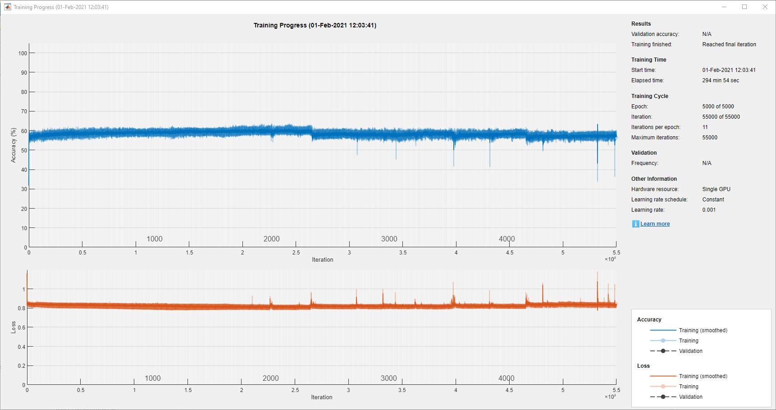
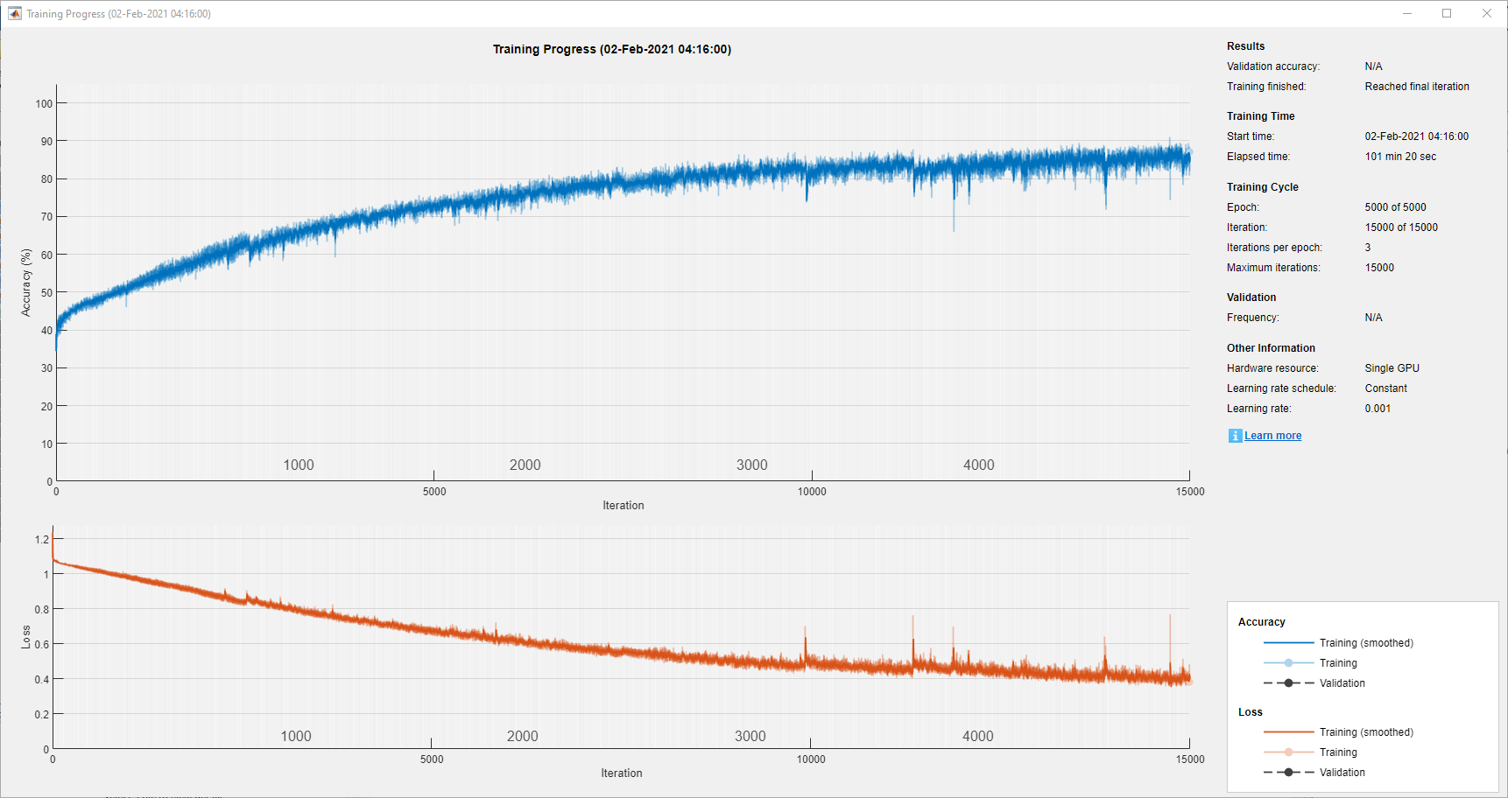
Conclusions
1. TEST CONCLUSIONS
Input Window & Symbol Count Require Further Investigation.
Large & Widely Classified Datasets Create Better Models.
Batch Size Does Not Matter at the End, but Increased Epoch is Vital.
Hidden Units Remains Unclear.
Notes:
Training Accuracy ≠ Actual Accuracy.

Slide 20
Conclusions
 | № | Precise Accuracy | Directional Accuracy | Model Earnings
Top 5 | 110 | 58,17% | 58,17% | $125,33
 | 109 | 4,41% | 56,55% | -$112,55
 | 125 | 55,53% | 55,53% | -$475,45
 | 128 | 55,14% | 55,14% | $404,21
 | 59 | 2,65% | 54,92% | -
Average | 106,2 | 35,18% | 56,06% | -$14,62
Bottom 5 | 72 | 6,72% | 6,59% | -
 | 66 | 6,85% | 6,85% | -
 | 30 | 11,34% | 16,17% | -
 | 133 | 30,65% | 30,41% | -$0,02
 | 117 | 32,77% | 32,77% | -$124,84
Average | 83,6 | 17,67% | 18,56% | -$62,43
2. PROJECT CONCLUSIONS
So… Can We Build a NN to Predict a Financial Market?
Cliché Conclusion: Yes & No.
“The determining trait of the enterprising investor is his willingness to devote time and care…” – B. Graham
Notes:
From 139 Models the Top 5 were created at around 106.
The Intelligent Investor by Benjamin Graham.

Slide 21

Thank you
Questions?
Comments?
Suggestions?

